Slide 1
APUSH Review: Key Concept 1.2 (The Columbian Exchange)
Period 1: 1491 - 1607
Everything You Need To Know About Key Concept 1.2 and The Columbian Exchange To Succeed In APUSH
Updated for the 2015 revisions

Slide 2
The New Curriculum and The Columbian Exchange
Key Concept 1.2 “Contact among Europeans, Native Americans, and Africans resulted in the Columbian Exchange and significant social, cultural, and political changes on both sides of the Atlantic Ocean.”
Page 26 of the Curriculum framework
The Columbian Exchange revolutionized life in the Americas, Europe, and Africa.
Big Ideas:
What were positives and negatives of the Columbian Exchange on both hemispheres?
What were reasons that led to European exploration?

Slide 3
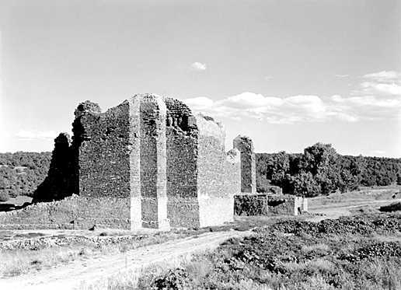
Key Concept 1.2, I
Key Concept 1.2, I: “European expansion into the Western Hemisphere generated intesnse social, religious, political, and economic competition and changes within European societies.”
Page 26 of the Curriculum framework
A) Reasons for European exploration:
Countries sought new sources of wealth – gold and silver
Economic and military competition – glory (defeat of the Spanish Armada by the English)
Spread Christianity – Spain
The Spanish often tried to convert Natives to Christianity
Spanish Mission System:
Outposts throughout the Americas to help convert Natives
Outposts were often military bases as well
3 G’s – Gold, Glory, Gospel

Slide 4
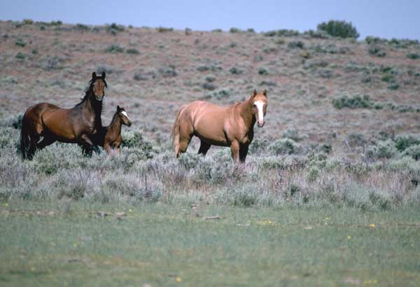
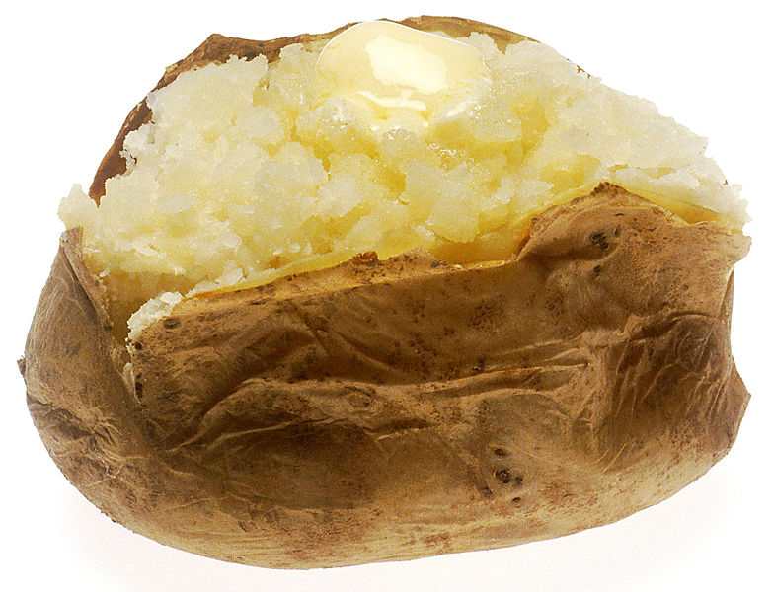
Key Concept 1.2, I
B) Columbian Exchange and its impacts
What was it?
The exchange of plants, animals, culture, humans, diseases, etc. between the Americas, Europe, and Africa
Examples of goods:
Americas to Europe and Africa: potatoes, maize (corn), tomatoes
Europe to the Americas: wheat, rice, horses, chickens, oxen
Impact of exchange?
In Europe and Asia: massive population growth due to new food; increase in wealth; decrease in feudalism and a rise of capitalism
In Africa: Spanish and Portuguese used Africans from West Africa to be used as slaves in the Americas
In the Americas: spread of diseases (smallpox and measles), social classes (Mestizos), horse transformed Native life (made hunting easier), Encomienda system

Slide 5
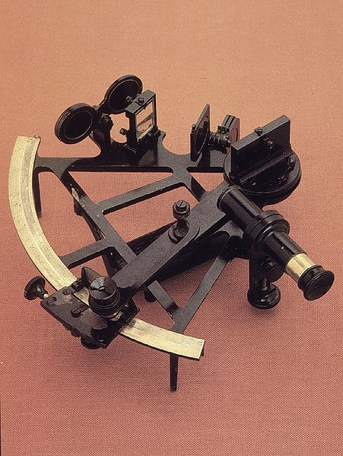
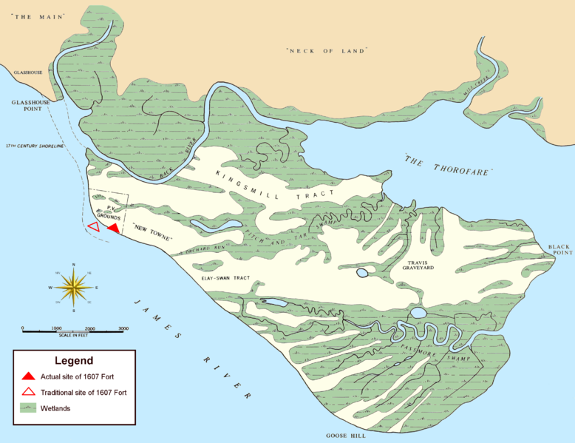
Key Concept 1.2, I
C) Technology and trade
New technology aided exploration:
Sextant – could be used to find exact position on earth – more precise sailing
Caravel, compass, and quadrant improved sailing efficiency
Economic improvements:
Joint-stock companies – used to raise $ for explorations
Used in Jamestown (1607)

Slide 6
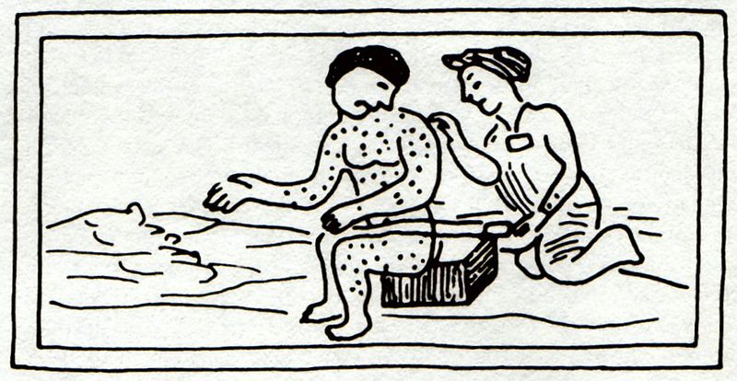
Key Concept 1.2, II
Key Concept 1.2, II: “The Columbian Exchange and development of the Spanish Empire in the Western Hemisphere resulted in extensive demographic, economic, and social changes.”
Page 27 of the Curriculum framework
A) Impact of Spanish exploration:
Deadly diseases:
Smallpox, malaria
Killed as many as 90% of Natives in some areas – not immune to European diseases
Introduction of new animals and crops:
Horse – transformed Native life on the Great Plains
Crops – wheat, rice, and sugar

Slide 7
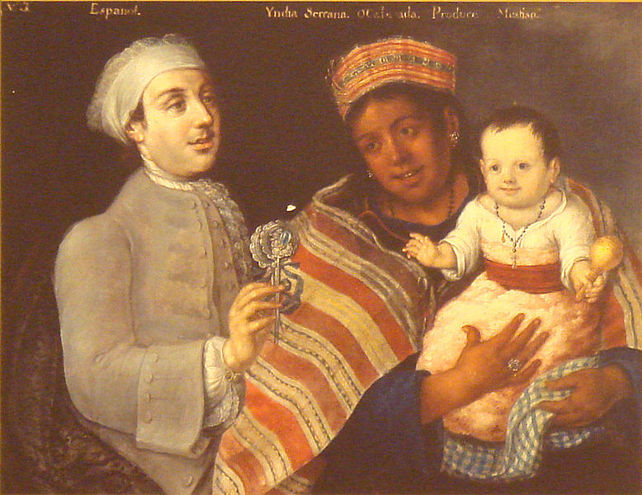
Key Concept 1.2, II
B) Encomienda System (Check out video in the description)
Native American labor was marshaled (arranged, assembled) on plantations
The goal was to use labor for agriculture and gain precious metal
Eventually, the encomienda system was replaced by African Slave Labor
New Laws of 1542 outlawed the encomienda system
C) Spanish and Portuguese traders acquired slaves from some West African groups
Slaves were used by the Spanish on plantations and mines
D) Spanish Caste System:
Incorporated Europeans, Africans, Natives
Europeans were at the top (peninsulares and creoles)
Mestizo and mulatos (mixed European and Native, European and African ancestry)

Slide 8
Key Concept 1.2, III
Key Concept 1.2, II: “In their interactions, Europeans and Native Americans asserted divergent worldviews regarding issues such as religion, gender roles, family, land use, and power.”
Page 28 of the Curriculum framework
A) Misunderstandings between each group
Gender – many Natives societies were matrilineal
Land – Natives did not own individual land
Religion – Natives believed in animism, polytheistic; shamans held power
Some useful aspects of each other’s cultures were eventually adapted:
Natives adapted technology
Europeans adapted agriculture techniques

Slide 9
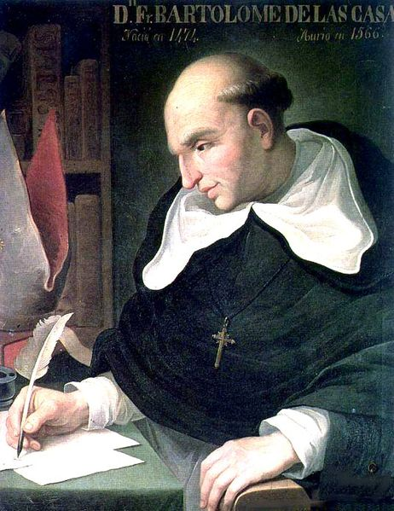
Key Concept 1.2, III
B) Native resistance to European encroachment and labor:
Natives sought to preserve political, economic, and religious autonomy (independence, self-rule)
Diplomatically and/or militarily
C) Debates over how non-Europeans should be treated:
Many Europeans saw Natives and Africans as “savages”
Juan de Sepulveda:
Advocated harsh treatment of Natives
Claimed slavery for Natives was justified under Christianity
Bartolome de Las Casas:
Argued that Natives deserved the same treatment as all other men
Played an instrumental role in the ending of the encomienda system
Contributed to the “Black Legend”
Arguments used to subjugate Africans and Natives?
Racism, religious - spread of Christianity, Natives and Africans were seen as “barbaric”

Slide 10
Test Tips
Multiple-Choice Questions and Short Answer:
Be familiar with the impacts of the Columbian Exchange – not just food
Increase in world trade, permanently connecting two hemispheres
Identify specific goods and their impacts – horse and potato
Encomienda System
Impact on Africans – drastic growth in slavery
Essay Questions:
European interactions with Native Americans
Could be part of larger topic – comparing Spanish colonization with other European countries (Period 2)

Slide 11
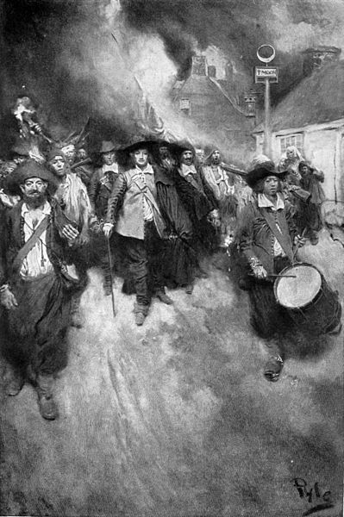
See You Back Here For Key Concept 2.1!
Thanks for watching!
Good luck in May
Please subscribe and share
Check out APUSHReview.com for many more resources
Practice Multiple-Choice Questions

